Slide 1

Pattern avoidance in binary trees
Namrata
Permutation Patterns 2022
joint work with Torsten Mütze

Slide 2
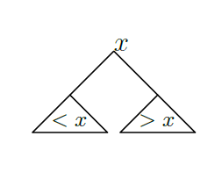
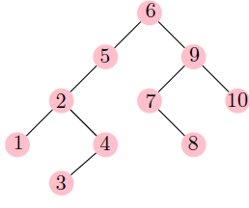
Introduction
Binary trees
Root vertex at the top.
Each vertex has at most two children.
Search property.
Study set of binary trees characterized by pattern avoidance.
Key Questions
How many trees are there that avoid some pattern?
Can we generate them efficiently?

Slide 3
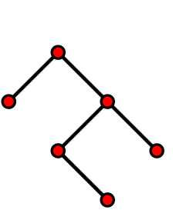



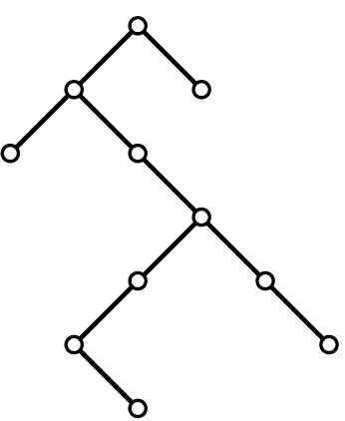
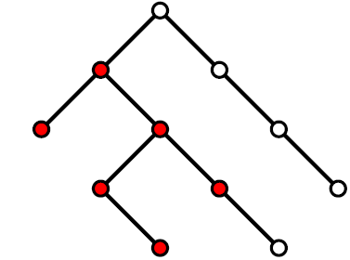
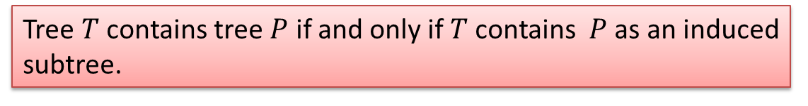


Tree patterns (Rowland, 2009)
Contiguous tree pattern
Tree $T$ contains tree $P$ if and only if $T$contains $P$ as an induced subtree.
Example :
$$T contains P$$
$$T′ avoids P$$

Slide 4



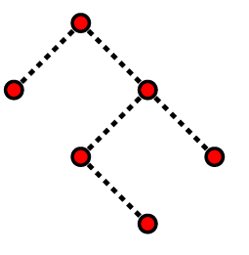
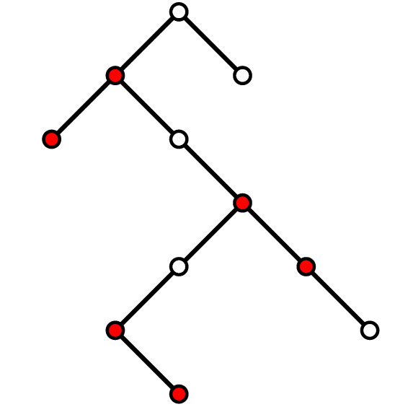
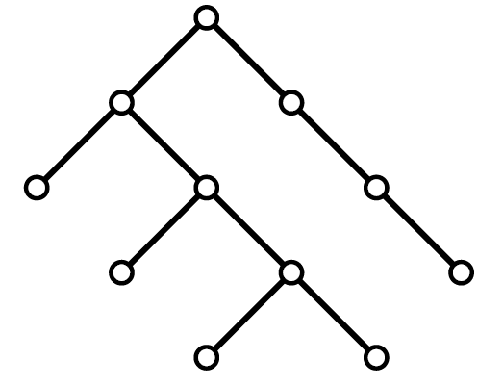


Tree patterns (Pudwell et al,2011)
Non-contiguous tree pattern
Tree $T$ contains tree $Q$ if and only if $T$contains $Q$ as a minor.
Example :
$$T′ contains Q$$
$$T′′ avoids Q$$

Slide 5



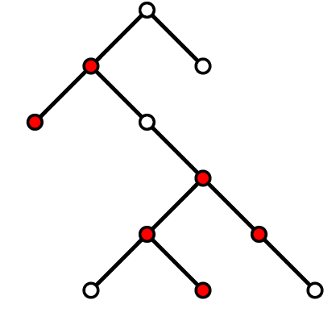
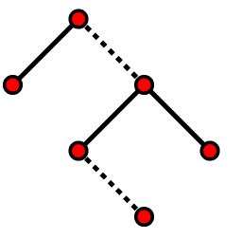
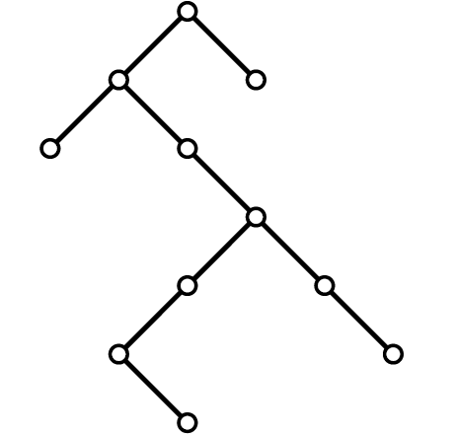
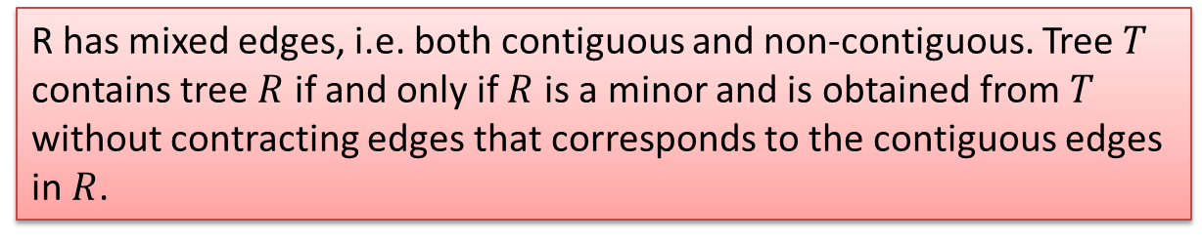


Tree patterns
Mixed tree pattern
R has mixed edges, i.e. both contiguous and non-contiguous. Tree $T$ contains tree $R$ if and only if $R$ is a minor and is obtained from$T$ without contracting edges that corresponds to the contiguous edges in $R$.
Example :
$$T′′′ contains R$$
$$T′ avoids R$$

Slide 6
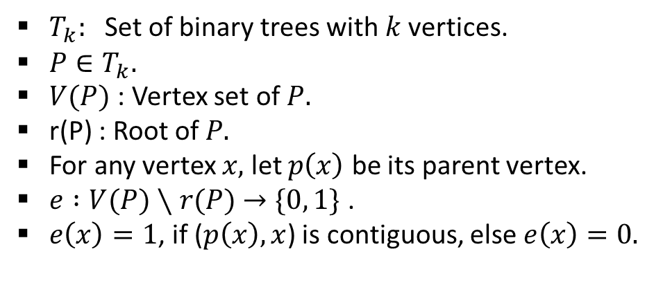
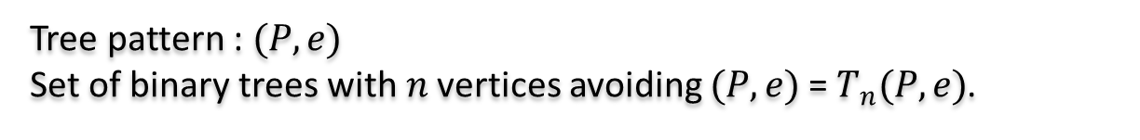

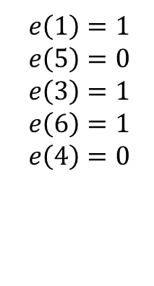
Preliminaries
$T_{k}:$Set of binary trees with $k$vertices.
$P∈T_{k}.$
$V(P)$ : Vertex set of $P.$
r(P) : Root of $P.$
For any vertex $x,$ let $p\left(x\right)$ be its parent vertex.
$e :V(P)∖r(P)$ $→\{0, 1\}$ .
$e\left(x\right)=1$, if ($p\left(x\right), x$) is contiguous, else $e\left(x\right)=0.$
Tree pattern : $(P, e)$
Set of binary trees with $n$vertices avoiding $(P, e)$ = $T_{n}(P, e)$.
$$P$$
2
$$e\left(1\right)=1$$
$$e\left(5\right)=0$$
$$e\left(3\right)=1$$
$$e\left(6\right)=1$$
$$e\left(4\right)=0$$
1
5
3
6
4

Slide 7



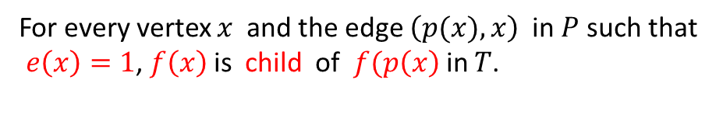
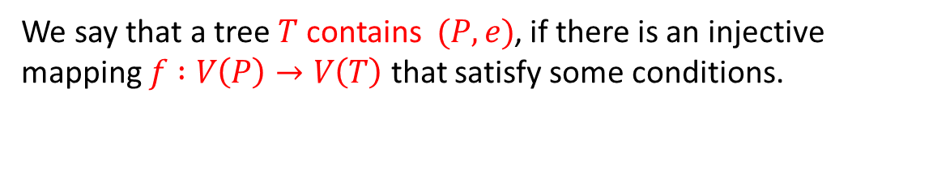

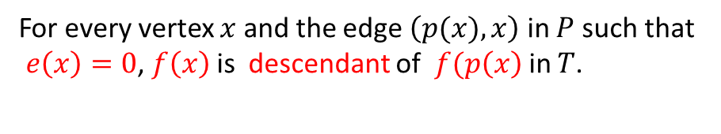





Definition of pattern containment
We say that a tree $T$ contains $(P, e)$, if there is an injective mapping $f :V\left(P\right)→V\left(T\right)$ that satisfy some conditions.
$$P$$
$$T$$
2
$f(2$)
1
5
$f(1$)
$f(5$)
6
$f(3$)
$f(6$)
3
4
$$f$$
$f(4$)
$e\left(1\right)=1$ , $e\left(5\right)=0,e\left(3\right)=1$, $e\left(6\right)=1,e\left(4\right)=0$
For every vertex $x$ and the edge $\left(p(x), x\right)$ in $P$ such that
$e\left(x\right)=0$, $f\left(x\right)$is descendant of $f(p\left(x\right)$in $T$.
For every vertex $x$ and the edge $\left(p(x), x\right)$ in $P$ such that
$e\left(x\right)=1$, $f\left(x\right)$is child of $f(p\left(x\right)$in $T$.

Slide 8
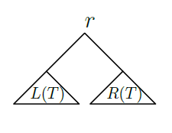
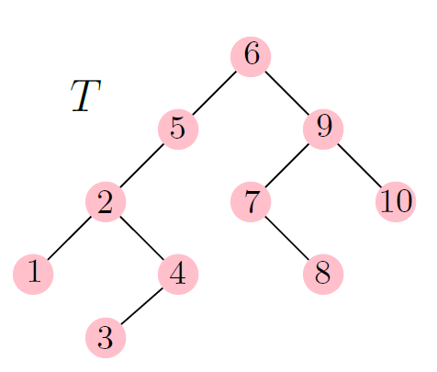
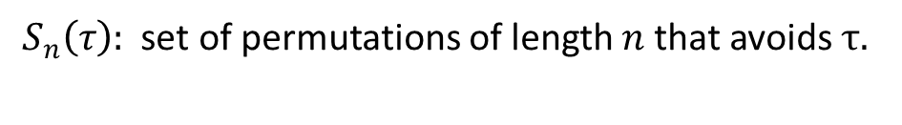
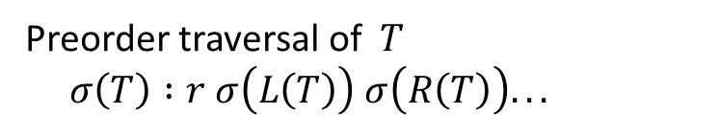
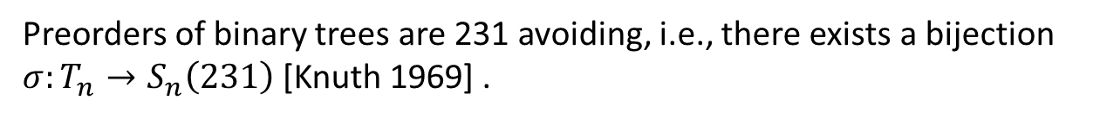

Trees and permutations
Preorder traversal of $T$
$σ\left(T\right) :r σ\left(L\left(T\right)\right) σ\left(R\left(T\right)\right)...$
$σ(T)$ : 6 5 2 1 4 3 9 7 8 10
$S_{n}\left(τ\right):$ set of permutations of length $n$ that avoids $τ.$
Preorders of binary trees are 231 avoiding, i.e., there exists a bijection
$σ:T_{n}→S_{n}\left(231\right)$[Knuth 1969] .
Now what about a tree that avoids a tree pattern?

Slide 9
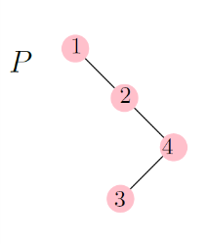
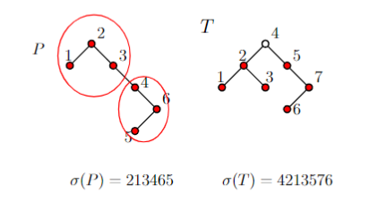
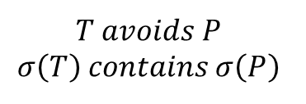

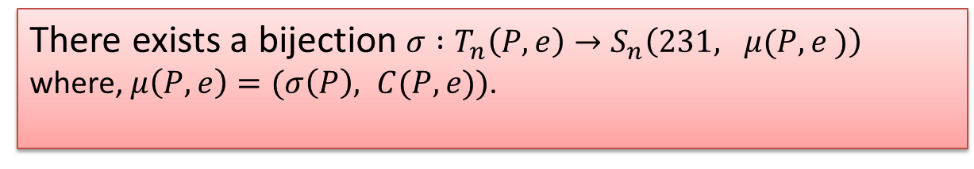


...continued
$σ(P)$ : 1 2 4 3
$σ(T)$ : 6 5 2 1 4 3 9 7 8 10
Can we say $σ(T)$ avoids 231 and $σ(P)$?
No
Generalizes the result of Pudwell et al [PSSS 12].
$$T avoids P$$
$$σ\left(T\right) contains σ\left(P\right)$$
Theorem 1
There exists a bijection $σ :T_{n}\left(P, e\right)→S_{n}\left(231, μ(P, e )\right)$
where, $μ\left(P, e\right)=(σ\left(P\right), C(P, e))$.
Mesh pattern

Slide 10



Bijection
13
12
2
2
11
1
7
10
9
3
8
8
7
5
9
6
4
6
5
13
4
11
3
2
10
12
1
$$(P, e)$$
$$μ\left(P, e\right)=(σ\left(P\right), C(P, e))$$
$$σ\left(P\right):2 1 7 3 5 4 6 8 9 13 11 10 12$$

Slide 11



Bijection
$$T$$
13
12
2
2
11
1
7
10
9
3
8
8
7
5
9
6
5
4
6
13
4
3
11
2
10
12
1
$$(P, e)$$
$$μ\left(P, e\right)=(σ\left(P\right), C(P, e))$$
$$σ\left(P\right):2 1 7 3 5 4 6 8 9 13 11 10 12$$

Slide 12
Bijection
13
12
2
2
11
1
7
10
9
3
8
8
7
5
9
6
4
6
5
13
4
11
3
2
10
12
1
$$(P, e)$$
$$μ\left(P, e\right)=(σ\left(P\right), C(P, e))$$
$$σ\left(P\right):2 1 7 3 5 4 6 8 9 13 11 10 12$$

Slide 13
Bijection
13
12
2
2
11
1
7
10
9
3
8
8
7
5
9
6
4
6
5
13
4
11
3
2
10
12
1
$$(P, e)$$
$$μ\left(P, e\right)=(σ\left(P\right), C(P, e))$$
$$σ\left(P\right):2 1 7 3 5 4 6 8 9 13 11 10 12$$

Slide 14
Bijection
13
12
2
2
11
e(7) = 1
1
7
10
9
3
8
8
7
5
9
6
4
6
5
13
4
11
3
2
10
12
1
$$(P, e)$$
$$μ\left(P, e\right)=(σ\left(P\right), C(P, e))$$
$$σ\left(P\right):2 1 7 3 5 4 6 8 9 13 11 10 12$$

Slide 15
Bijection
13
12
2
2
11
e(7) = 1
1
7
10
9
3
8
8
e(3) = 1
7
5
9
6
4
6
5
13
4
11
3
2
10
12
1
$$(P, e)$$
$$μ\left(P, e\right)=(σ\left(P\right), C(P, e))$$
$$σ\left(P\right):2 1 7 3 5 4 6 8 9 13 11 10 12$$

Slide 16
Bijection
13
12
2
2
11
e(7) = 1
1
7
10
9
3
8
8
e(3) = 1
7
5
9
6
4
6
5
13
4
11
e(11) = 1
3
2
10
12
1
$$(P, e)$$
$$μ\left(P, e\right)=(σ\left(P\right), C(P, e))$$
$$σ\left(P\right):2 1 7 3 5 4 6 8 9 13 11 10 12$$

Slide 17
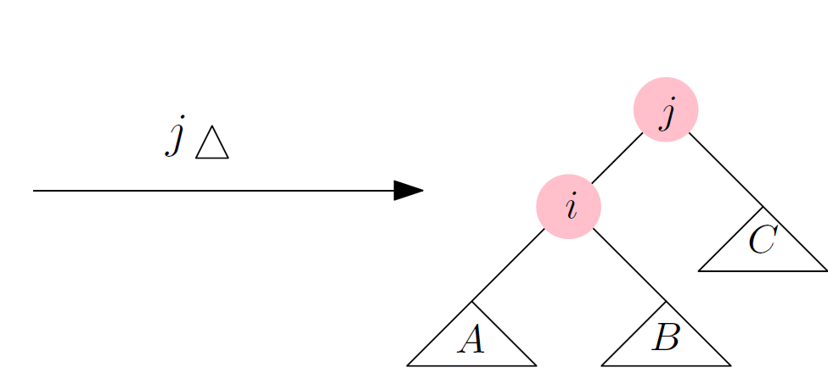
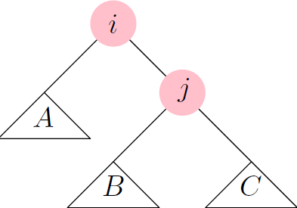
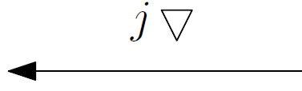
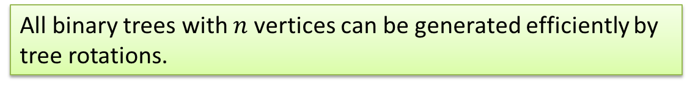

Exhaustive generation of trees
Consecutive objects differ by a local change – Gray code.
Binary trees by rotations with respect to an edge.
$$i<j$$
Theorem[Baronaigien, Lucas, and Ruskey, 1993] :
All binary trees with $n$vertices can be generated efficiently by tree rotations.

Slide 18

...continued
The tree rotation algorithm is a special case of the permutations generation
framework. [Hartung, Hoang, Mütze, and Williams, SODA 2020]
Framework relies on encoding combinatorial objects by permutations.
Trees avoiding patterns
$$σ$$
Permutations avoiding patterns

Slide 19

A simple greedy algorithm to generate $T_{n}(P, e)$
Visit the initial all-right tree.
Generate an unvisited binary tree by a minimal sequence of up- or down-rotation of the largest possible vertex. If no such rotation exists, or if the direction of the rotation is ambiguous, then terminate.
Repeat.

Slide 20
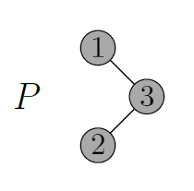
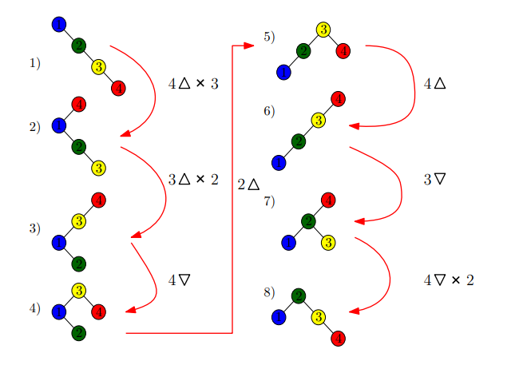
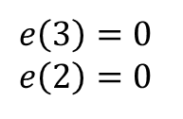
An example of generation
$$e\left(3\right)=0$$
$$e\left(2\right)=0$$

Slide 21
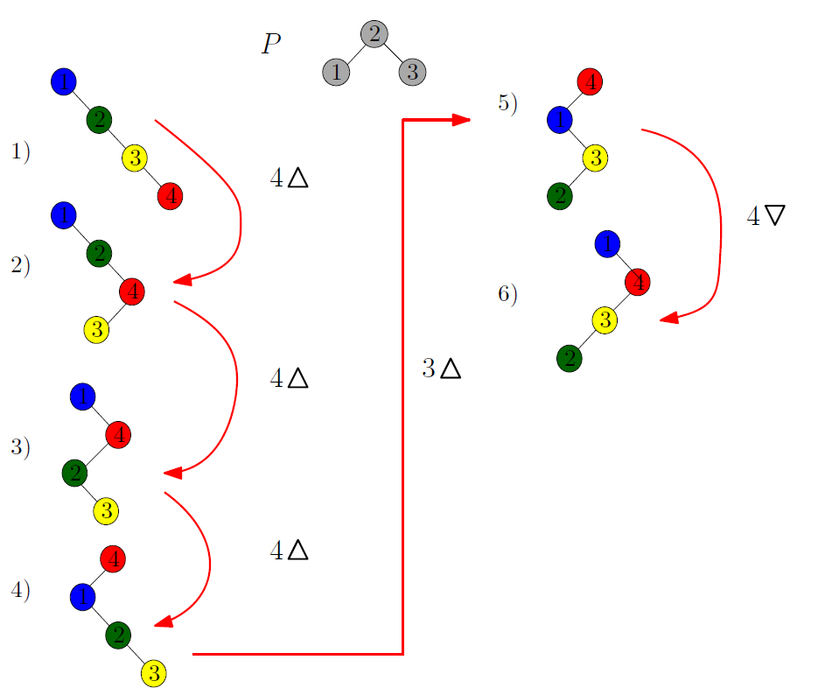
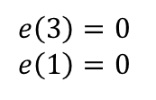
Algorithm terminates without generating everything!
$$e\left(3\right)=0$$
$$e\left(1\right)=0$$
Terminates !!

Slide 22
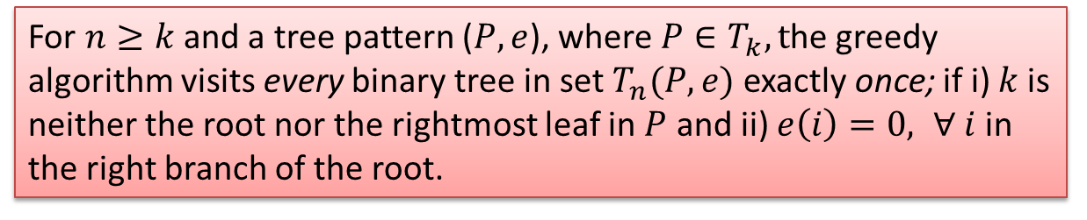
Main Results
Theorem 2
For $n≥k$ and a tree pattern ($P, e$), where $P∈T_{k}, t$he greedy algorithm visits every binary tree in set $T_{n}(P, e)$ exactly once; if i) $k$is neither the root nor the rightmost leaf in $P$ and ii) $e\left(i\right)=0, ∀ i$in the right branch of the root.
Theorem 3
The greedy algorithm can be made history-free.

Slide 23
Thank You!

